Slide 1
Grievance Mechanism
Top Glove Corporation Bhd
A grievance SOP is in place which requires corrective action for issues
raised to be taken within 5 days.

Slide 2
Available Grievance Channels for Employees to Raise Concerns
1. Multilingual Independent Grievance Helpline (external)
Managed by independent 3rd party auditor: Impactt UK
Available in multiple workers’ languages
6. Engagement with Independent Directors
Quarterly meeting with workers’ representatives
5. Centralized Workers Helpline, Email, Grievance Forms, WhatsApp and HR Connect Apps grievance
Various platforms for workers to raise workplace, safety, health, accommodation etc. issues
Grievance raised will be channeled to HQ Social Compliance team
2. Whistleblowing Channels
Managed by independent third party
Oversight by Whistleblowing Committee
Channels: online form, email, mail box (external)
3. Workers Welfare Committee
Worker Representative in each nationality & gender in every factory
Monthly engagement with HR
4. TG Care Lines
Care lines for workers to report harassment and bullying cases

Slide 3
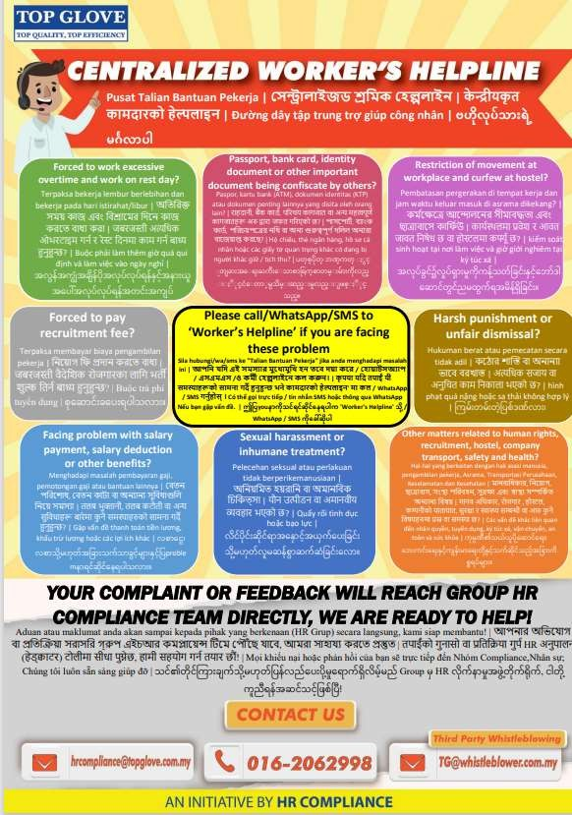
Centralized Worker’s Helplines

Slide 4
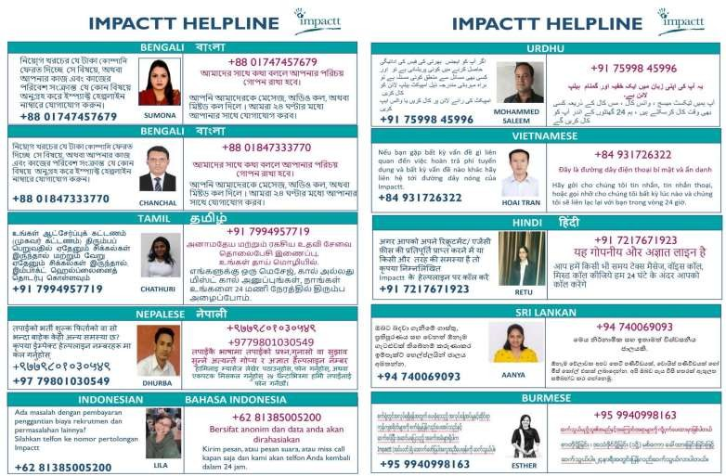
Multilingual Independent Grievance Helplines

Slide 5
FY2023 Grievance Data
We work with Impactt Limited which managed for Top Gloves, an independent grievance helpline available in multiple workers’ language. In FY2023, a total 40 cases received with 98% of the cases resolved and closed with remaining 1 pending Impactt’s verification on the action taken by the Company.

